Slide 1
MODERN ATOMIC THEORY
1. Background (Light & Energy)

Slide 2
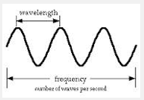
A. Electromagnetic Radiation
How do light and energy provide the background for the modern atomic theory?
Definition: Energy that exhibits wave-like behavior.
Illustration:

Slide 3


A. Electromagnetic Radiation
How do light and energy provide the background for the modern atomic theory?
Different types of electromagnetic radiation have different wavelengths (λ).
Chart:
_____ ______ ______ Visible Light ______ ______ ______
Short Long
Gamma Rays
Radio Waves
X-Rays
Ultraviolet
Infrared
Microwaves
VIBGYOR

Slide 4
B. Dual Wave-Particle Nature
How do light and energy provide the background for the modern atomic theory?
Wave
Particles o o o o o o o o o o o
⇧ Stream of Photons
“Particles” of Electromagnetic Radiation

Slide 5
C. How Atoms Emit Energy
How do light and energy provide the background for the modern atomic theory?
☐➔☐➔☐➔☐
Ground Excited Photons Ground
State State Released State
e– gain energy
e–
e–
e–
e–
1 p⁺
1 p⁺
1 p⁺
1 p⁺
e– are in their lowest energy level
e– move to higher energy level
e– lose their energy in the form of light
e– return to their lowest energy level

Slide 6
C. How Atoms Emit Energy
How do light and energy provide the background for the modern atomic theory?
THOUGHT QUESTION: If hydrogen and helium only have electrons in the first energy level, do they absorb and release the same amount of energy? Justify your answer.
Hydrogen
Helium
e–
e–
1p⁺
2p⁺
e–

Slide 7
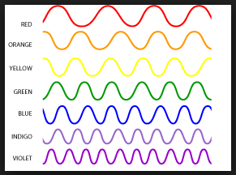
C. How Atoms Emit Energy
How do light and energy provide the background for the modern atomic theory?
Different colors represent different wavelengths which correspond to different amounts of energy.

Slide 8
D. Quantized Energy Levels
How do light and energy provide the background for the modern atomic theory?
Excited hydrogen atoms can emit photons only of certain energies (different wavelengths). They never emit photons with different energies (not 600 nm, 420 nm, etc.)
656 nm = RED 434 nm = BLUE
486 nm = GREEN 410 nm = PURPLE

Slide 9
D. Quantized Energy Levels
How do light and energy provide the background for the modern atomic theory?
The energy levels are quantized, meaning only certain values are allowed.
Excited States:
__________________
__________________
__________________
__________________

Slide 10
E. Bohr Model
How do light and energy provide the background for the modern atomic theory?
Electrons move in orbits that correspond to the different energy levels.
Electrons can “jump” orbits by either absorbing or emitting photons.

Slide 11
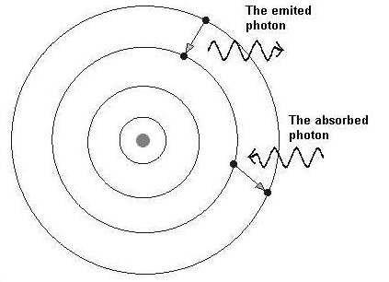
E. Bohr Model
How do light and energy provide the background for the modern atomic theory?
Illustration:

Slide 12
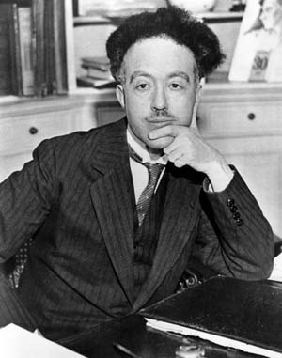
F. Developing the QM Model
How do light and energy provide the background for the modern atomic theory?
Louis de Broglie – 1924
Electrons have a dual wave–particle nature like light.
If light can act like a particle, can a particle act like a wave?

Slide 13
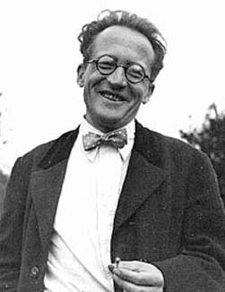
F. Developing the QM Model
How do light and energy provide the background for the modern atomic theory?
Erwin Schrödinger – 1926
Schrödinger Wave Equation: Mathematically described the wave properties of electrons.
Electrons exist in orbitals. Orbitals are 3D regions that indicate the probable location of an electron.

Slide 14
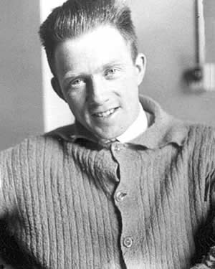
F. Developing the QM Model
How do light and energy provide the background for the modern atomic theory?
Werner Heisenberg – 1927
Quantum Mechanics: the study of subatomic particle motion and interaction
Uncertainty Principle [ΔxΔp>h; ΔEΔt>h]
The probability map for an electron is called an orbital.
The position and velocity of electrons is always changing.

Slide 15
MODERN ATOMIC THEORY
2. Electron Orbitals

Slide 16
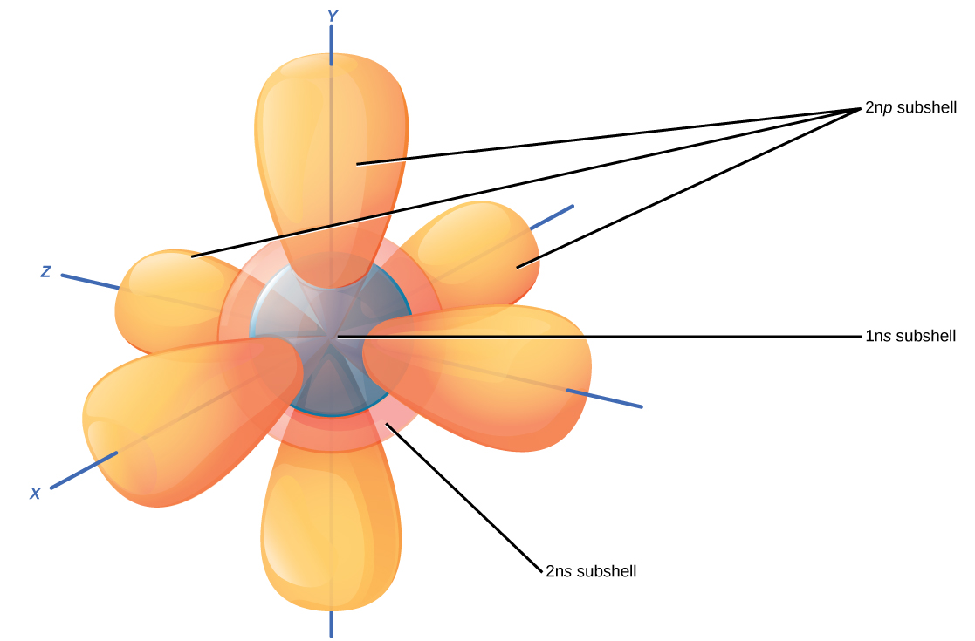
2. Electron Orbitals
What are the various orbitals that hold electrons?
Electron Orbital: A 3-D region around an atom that indicates the PROBABLE location of an electron
Orbitals can be described by:
Size / Energy Level
Shape
Orientation
The first three quantum numbers are used to designate these features. The fourth quantum number describes the position of electrons inside an orbital. They are mathematically determined.

Slide 17
2. Electron Orbitals
What are the various orbitals that hold electrons?
Electron Orbital: A 3-D region around an atom that indicates the PROBABLE location of an electron
Orbitals can be described by:
Size / Energy Level
Shape
Orientation
The first three quantum numbers are used to designate these features. The fourth quantum number describes the position of electrons inside an orbital. They are mathematically determined.

Slide 18
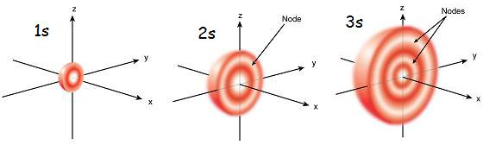
The 4 Quantum Numbers
What are the various orbitals that hold electrons?
1. Size / Energy Level (Principal Quantum Number: n)
As n increases, the electron’s energy and distance from the nucleus increases.
Illustration: s

Slide 19
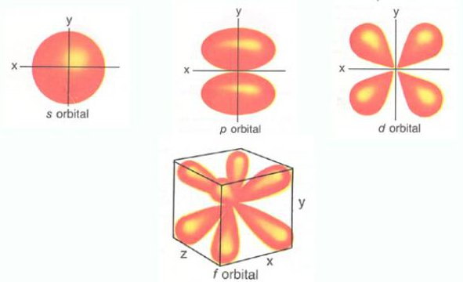
The 4 Quantum Numbers
What are the various orbitals that hold electrons?
2. Shape (Angular Momentum Quantum Number: l)
s
p
EXTRA:
s = 0 p = 1 d = 2
f = 0

Slide 20
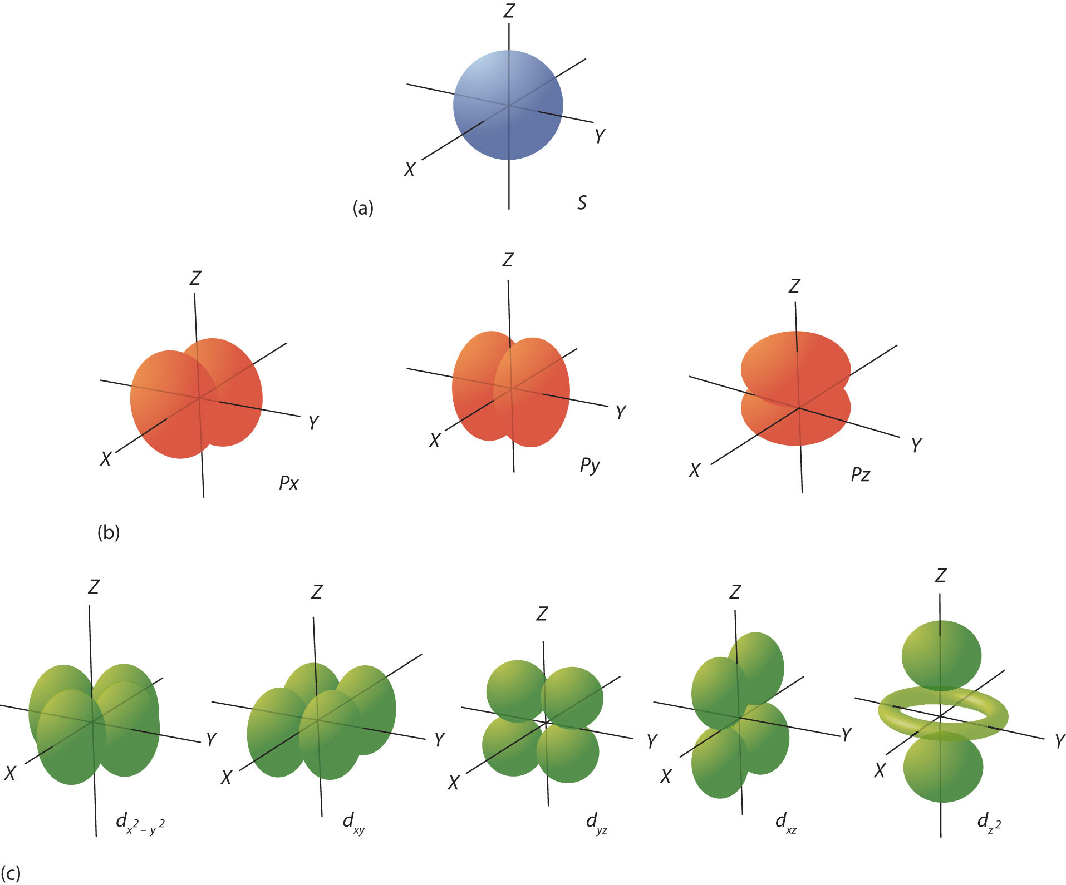
The 4 Quantum Numbers
What are the various orbitals that hold electrons?
3. Orientation (Magnetic Quantum Number: m_{l})
s
p
d

Slide 21
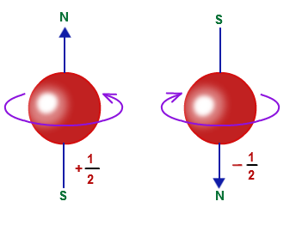
The 4 Quantum Numbers
What are the various orbitals that hold electrons?
4. Spin (Magnetic Quantum Number: m_{s})
Spin up: Spin down:
p
d

Slide 22
The 4 Quantum Numbers
What are the various orbitals that hold electrons?
1. Size / Energy Level (Principal Quantum Number: n)
n = 1, 2, 3, 4, 5, etc.
2. Shape (Angular Momentum Quantum Number: l)
l = n – 1 ; 0, 1, 2, 3, 4, 5, etc.
3. Orientation (Magnetic Quantum Number: m_{l})
m_{l} =± l; -5, -4, -3, -2, -1, 0, 1, 2, 3, 4, 5, etc.
4. Spin (Magnetic Quantum Number: m_{s})
m_{s} = ±½

Slide 23
Principles/Rules
What are the various orbitals that hold electrons?
Aufbau Principle
An electron occupies the lowest energy ORBITAL it can. PUT THIS ON YOUR CONVERSION SHEET: 1s
2s 2p
3s 3p 3d
4s 4p 4d 4f
5s 5p 5d 5f 5g
6s 6p 6d 6f 6g 6h
7s 7p 7d 7f 7g 7h 7i

Slide 24

Principles/Rules
What are the various orbitals that hold electrons?
Pauli Exclusion Principle
No two electrons in the same atom can have the same set of 4 quantum numbers. (No two electrons can have the same spin in the same orbital.) 7i

Slide 25
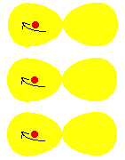
Principles/Rules
What are the various orbitals that hold electrons?
Hund’s Rule
Orbitals of equal energy are each occupied by 1 electron before any orbital is occupied by a second electron, and these first electrons all have the same spin. 7i

Slide 26
Chart – Orbitals
What are the various orbitals that hold electrons?
Energy Level n | Shape l ≤ n – 0 | Number of Orientations; m_{l} ≤±l | Number of Electrons
1 | s (l = 0) | 1; | 1 x 2 = 2
2 | s (l = 0) | 1; | 1 x 2 = 2
2 | p (l = 1) | 3; | 3 x 2 = 6
3 | s (l = 0) | 1; | 1 x 2 = 2
3 | p (l = 1) | 3; | 3 x 2 = 6
3 | d (l = 2) | 5; | 5 x 2 = 10

